Slide 1
Lesson 8: Implementing and Consuming REST Services
8.1 Getting Started with REST Services in Spring Boot
8.2 Defining a Simple REST Service
8.3 Defining a Full REST API
8.4 Implementing POST, PUT, and DELETE Endpoints
8.5 Defining a REST Client
8.6 Consuming REST Endpoints

Slide 2
Lesson 8: Implementing and Consuming REST Services
8.1 Getting Started with REST Services in Spring Boot

Slide 3
Creating a Spring Boot Web Application
To create a web app, add the Spring Web dependency:
Alternatively, add the Spring Reactive Web dependency
Good if you have very high load or a continuous stream of data
<dependency>
<groupId>org.springframework.boot</groupId>
<artifactId>spring-boot-starter-web</artifactId>
</dependency>
We'll do this
pom.xml
<dependency>
<groupId>org.springframework.boot</groupId>
<artifactId>spring-boot-starter-webflux</artifactId>
</dependency>
pom.xml

Slide 4
The Role of REST Services
A REST service is an endpoint in a web application
Has methods that are mapped to URLs
Easily accessible by clients over HTTP(S)
Consume/return data, typically JSON (or XML)
The role of REST services in a full-stack application:
Callable from UI, e.g., from a React web UI
Provides a façade to back-end data/functionality

Slide 5
REST Services in Spring MVC
This is how REST services work in Spring MVC:
HTTP request
aMethod
HTTP response
DispatcherServlet
bean created by Spring Boot
Controller bean
implemented by you
Other beans
e.g. repositories
Spring Boot application

Slide 6
Supporting JSON and XML
REST controller methods receive/return Java objects
Spring Boot automatically creates a JSON serializer bean, to convert Java objects to/from JSON
If you also want to support XML serialization, you must add the following dependency:
<dependency>
<groupId>com.fasterxml.jackson.dataformat</groupId>
<artifactId>jackson-dataformat-xml</artifactId>
</dependency>
pom.xml

Slide 7
Defining a Model Class
We'll use the following POJO class in our REST services:
The JSON/XML serializers will convert Product objects to/from JSON/XML automatically, as appropriate
public class Product {
private long id;
private String description;
private double price;
// Plus constructors, getters/setters, etc …
}
Product.java

Slide 8
Lesson 8: Implementing and Consuming REST Services
8.2 Defining a Simple REST Service

Slide 9
How to Define a REST Controller
Define a class and annotate with:
@Controller (or @RestController)
@RequestMapping (optional base URL)
@CrossOrigin (optional CORS support)
Define methods annotated with one of the following:
@GetMapping, @PostMapping, @PutMapping, @DeleteMapping,@RequestMapping
For each method, also specify the path (URL) and data-types

Slide 10
Example REST Controller
Here's a simple REST controller
The method returns product collection:
@RestController
@RequestMapping("/simple")
@CrossOrigin
public class SimpleController {
private Map<Long, Product> catalog = new HashMap<>();
…
@GetMapping(
value="/productsV1",
produces={"application/json","application/xml"}
)
public Collection<Product> getProductsV1() {
return catalog.values();
}
…
}
SimpleController.java

Slide 11
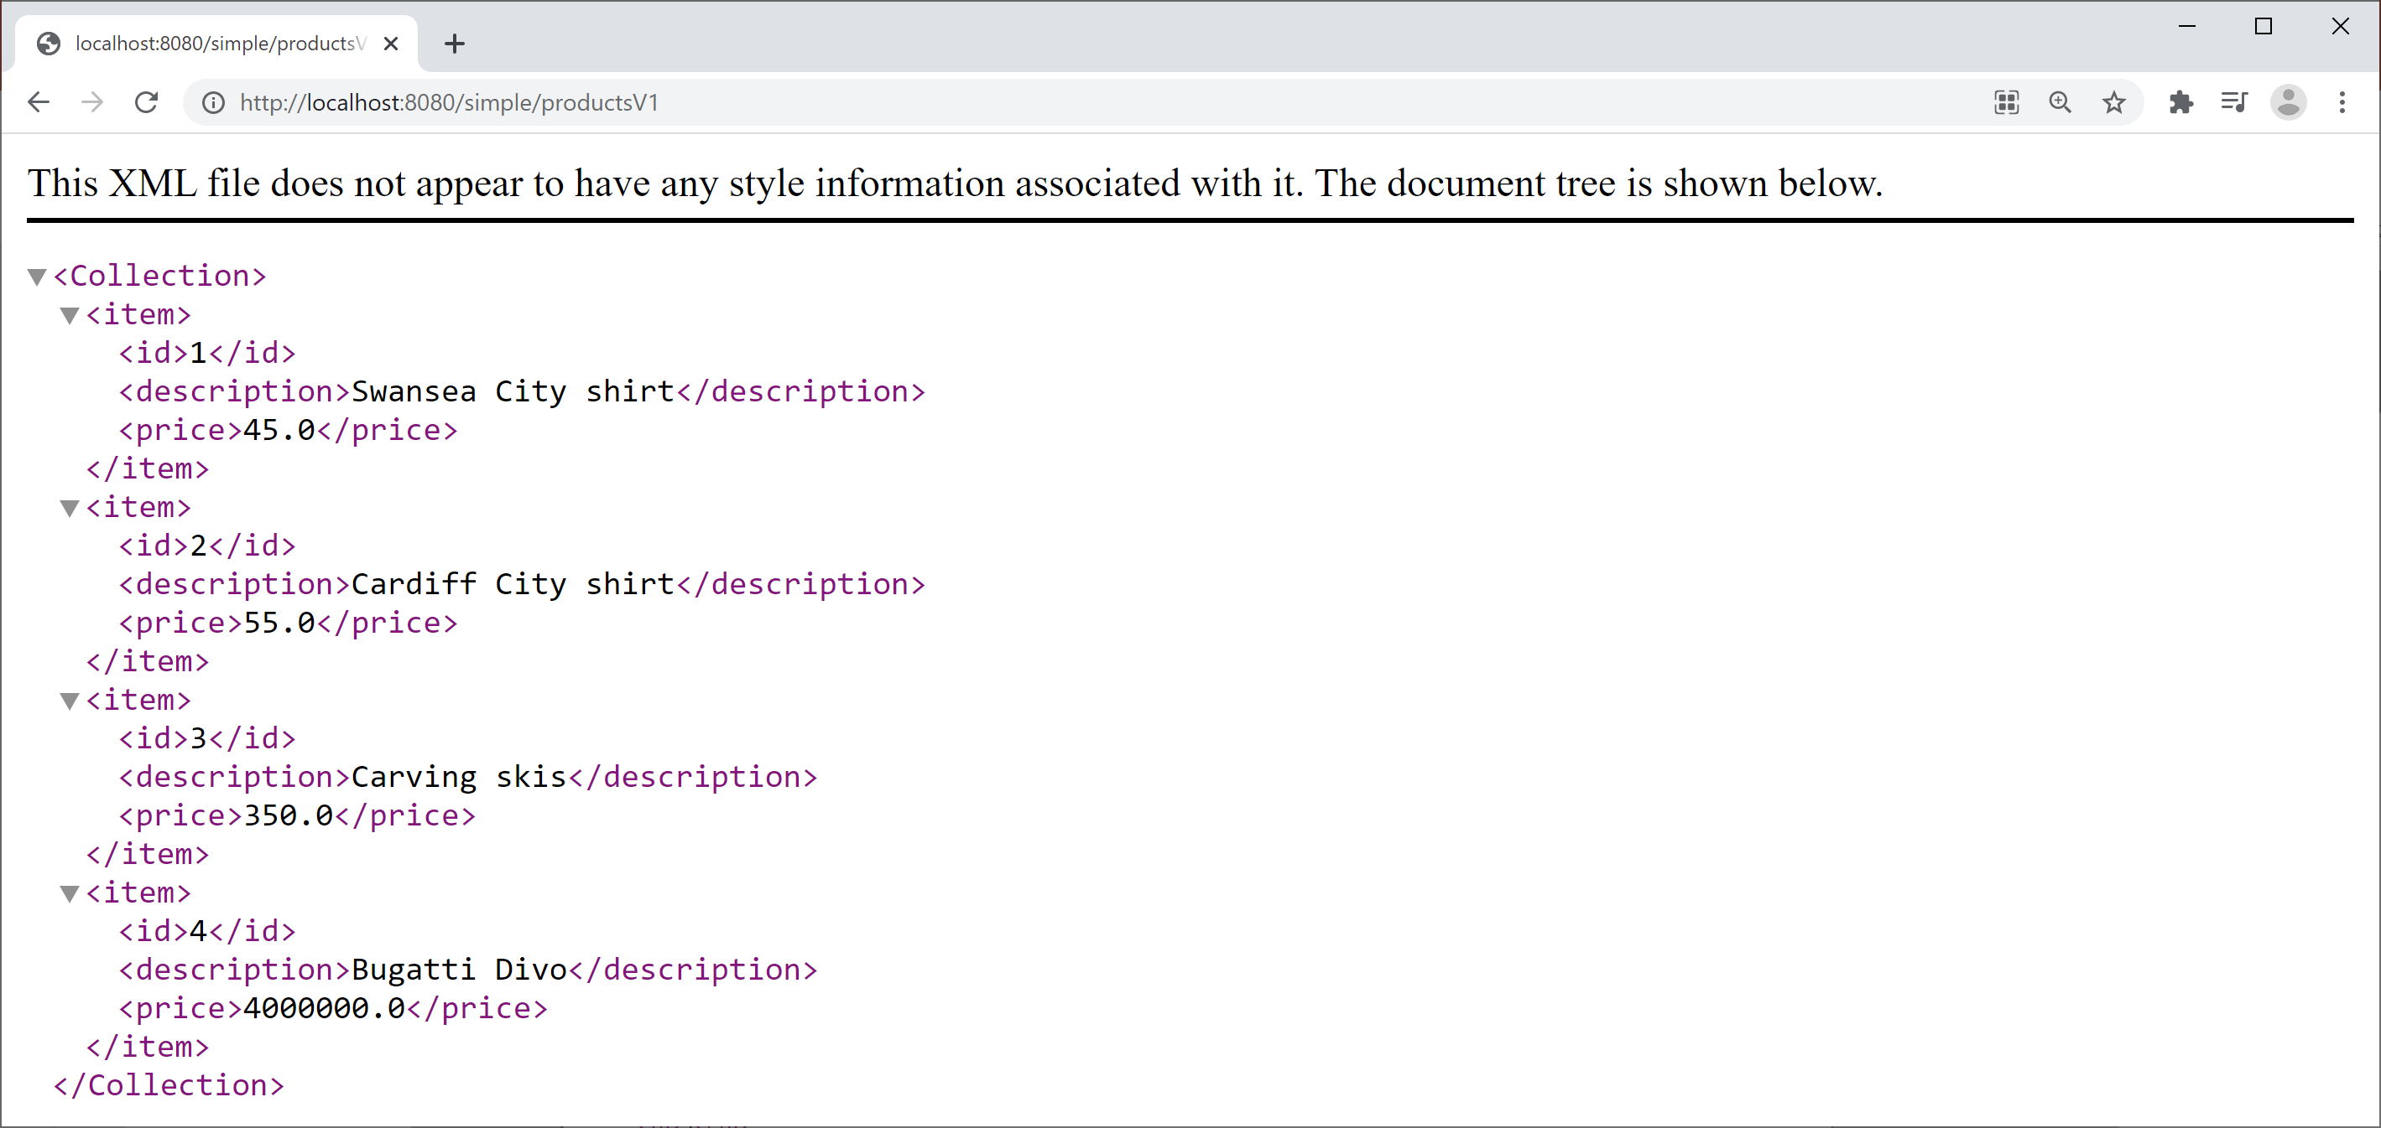
Pinging the Simple REST Controller
Run the Spring Boot app, then browse to:
http://localhost:8080/simple/productsV1

Slide 12
A Better Approach
So far, we return a Collection<Product>
This populates the HTTP response body
But it doesn't set the HTTP headers or status code
A better approach is to return ResponseEntity<T>
Gives control over entire HTTP response body
We can set HTTP headers and status code:
@GetMapping(
value="/productsV2",
produces={"application/json","application/xml"}
)
public ResponseEntity<Collection<Product>> getProductsV2() {
return ResponseEntity.ok().body(catalog.values());
}
SimpleController.java

Slide 13
Mapping Path Variables
You can map parts of the path to variables
In the path, define {…} placeholder(s)
In the method, annotate param with @PathVariable
@GetMapping(
value="/products/{id}",
produces={"application/json","application/xml"}
)
public ResponseEntity<Product> getProductById(@PathVariable long id) {
Product p = catalog.get(id);
if (p == null)
return ResponseEntity.notFound().build();
else
return ResponseEntity.ok().body(p);
}
SimpleController.java
http://localhost:8080/simple/products/1

Slide 14
Mapping Request Parameters
You can map HTTP request parameter(s)
In the path, optionally provide parameter(s) after ?
In the method, annotate param with @RequestParam
@GetMapping(
value="/products",
produces={"application/json","application/xml"})
public ResponseEntity<Collection<Product>> getProductsMoreThan(
@RequestParam(value="min", required=false, defaultValue="0.0") double min) {
Collection<Product> products = catalog.values()
.stream()
.filter(p -> p.getPrice() > min)
.collect(Collectors.toList());
return ResponseEntity.ok().body(products);
}
SimpleController.java
http://localhost:8080/simple/products?min=100

Slide 15
Lesson 8: Implementing and Consuming REST Services
8.3 Defining a Full REST API

Slide 16
Overview
So far, we've seen how to GET data from a REST service:
Here's how to support the other HTTP verbs:
@GetMapping(value= … )
@PostMapping(value= … )
@PutMapping(value= … )
@DeleteMapping(value= … )

Slide 17
Example REST Controller
Here's the example REST controller for our example:
Note:
We've defined a repository bean to manage data persistence
@RestController
@RequestMapping("/full")
@CrossOrigin
public class FullController {
@Autowired
private ProductRepository repository;
// Full CRUD API, see following slides
…
}
FullController.java

Slide 18
Testing the Example REST Controller
We'll test the service using the Advanced Rest Client
Install from https://install.advancedrestclient.com
Enables you to submit all kinds of requests to a URL:
GET, PUT, POST, DELETE, etc.
Enables you to set HTTP request headers:
E.g., Content-Type=application/json
E.g., Accept=application/json

Slide 19
Lesson 8: Implementing and Consuming REST Services
8.4 Implementing POST, PUT, and DELETE Endpoints

Slide 20
Implementing a POST Method
A POST method typically inserts a resource:
Client passes object in HTTP request body
Service returns enriched object after insertion
Service also returns status code 201 plus a LOCATION header
@PostMapping(
value="/products",
consumes={"application/json","application/xml"},
produces={"application/json","application/xml"})
public ResponseEntity<Product> insertProduct(@RequestBody Product product) {
repository.insert(product);
URI uri = URI.create("/full/products/" + product.getId());
return ResponseEntity.created(uri).body(product);
}
FullController.java

Slide 21
Implementing a PUT Method
A PUT method typically updates an existing resource:
Client passes id in URL
Client also passes an object in request body
Service returns status code 200 or 404
@PutMapping(value="/products/{id}", consumes={"application/json","application/xml"})
public ResponseEntity<Void> updateProduct(@PathVariable long id,
@RequestBody Product product) {
if (!repository.update(product))
return ResponseEntity.notFound().build();
else
return ResponseEntity.ok().build();
}
FullController.java

Slide 22
Implementing a DELETE Method
A DELETE method typically deletes an existing resource:
Client passes id in URL
Service returns status code 200 or 404
@DeleteMapping("/products/{id}")
public ResponseEntity<Void> deleteProduct(@PathVariable long id) {
if (!repository.delete(id))
return ResponseEntity.notFound().build();
else
return ResponseEntity.ok().build();
}
FullController.java

Slide 23
Lesson 8: Implementing and Consuming REST Services
8.5 Defining a REST Client

Slide 24
Overview
Spring enables you to implement client code to consume REST services
Via the RestTemplate class
Include the following POM dependency:
<dependency>
<groupId>org.springframework.boot</groupId>
<artifactId>spring-boot-starter-web</artifactId>
</dependency>
pom.xml

Slide 25
Key Methods in RestTemplate
Here are some of the key methods in RestTemplate:
ResponseEntity<T> getForEntity(String, Class<T>, Object...)
ResponseEntity<T> postForEntity(String, Object, Class<T>, Object...)
void put(String, Object, Object...)
void delete(String, Object...)
ResponseEntity<T> exchange(String, HttpMethod, object, Class<T>)

Slide 26
Lesson 8: Implementing and Consuming REST Services
8.6 Consuming REST Endpoints

Slide 27
Example
Let's see an example of how to consume REST endpoints:
REST request
REST client
MyRestClient
REST service
/full/products
REST response
demo-rest-clients
http://localhost:8181
demo-rest-services
http://localhost:8080

Slide 28
Key Classes in the REST Client Application
MyRestClient
Calls REST service endpoints, by using RestTemplate
Product
Product objects passed to/from REST service
Serialized/deserialized by RestTemplate

